Slide 1
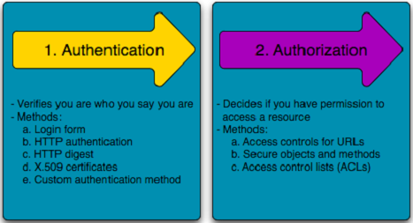
Lesson 4. Authentication

Slide 2
Outline
Introduction
Authentication factors
One Time Password (OTP)
Single-Sign-On (SSO)
Labs
Summary

Slide 3
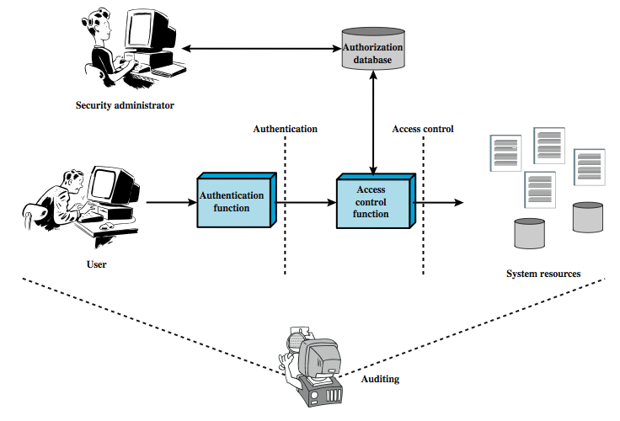






Introduction

Slide 4
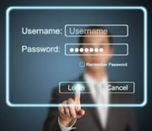
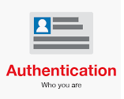



Introduction
Authentication is about validating your credentials such as Username/User ID and password to verify your identity.

Slide 5

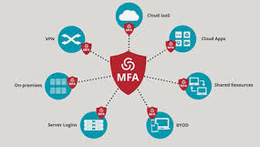

Introduction
Strong authentication is important
To be properly authenticated, the subject is usually required to provide a second piece to the credential set (i.e., password, passphrase, key, PIN, token etc.

Slide 6


Authentication factors
Authentication factors determine the many different elements the system uses to verify one’s identity before granting the individual access to anything.
something you know
Something you have
Something you are

Slide 7

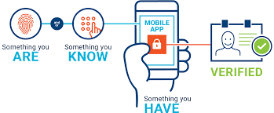



Authentication factors
Based on the security level, authentication factors can vary from one of the following:
Single- Factor Authentication
Two- Factor Authentication (2FA)
Multi- Factor Authentication (MFA)

Slide 8



Something you know (Knowledge-based)
Passwords are the most common form of authentication
PIN
Simple Password Authentication
User Name, Password
/etc/shadow

Slide 9
Something you know
User-entered Password
Password hash stored on file e.g. /etc/shadow
H1
Password Verification
Hash Function
H2
Y
H1==H2?
OK
N
FAIL

Slide 10
Something you know
“Passwords are one of the biggest practical problems facing security engineers today.”
Problems:
Easy to share (intentionally or not)
Easy to forget
Often easy to guess
Too many passwords to remember
Complex password policy
Forcing users to pick stronger passwords
Password vulnerabilities
Access the password file
Brute force attacks
Directory attacks
Social engineering

Slide 11

Strategies for strong passwords
Proactive password checking
Users select a potential password which is tested
Weak passwords are not accepted
Reactive password checking
SysAdmin periodically runs password cracking tools to detect weak passwords that must be replaced
Computer-generated passwords
Random passwords are strong but difficult to remember

Slide 12

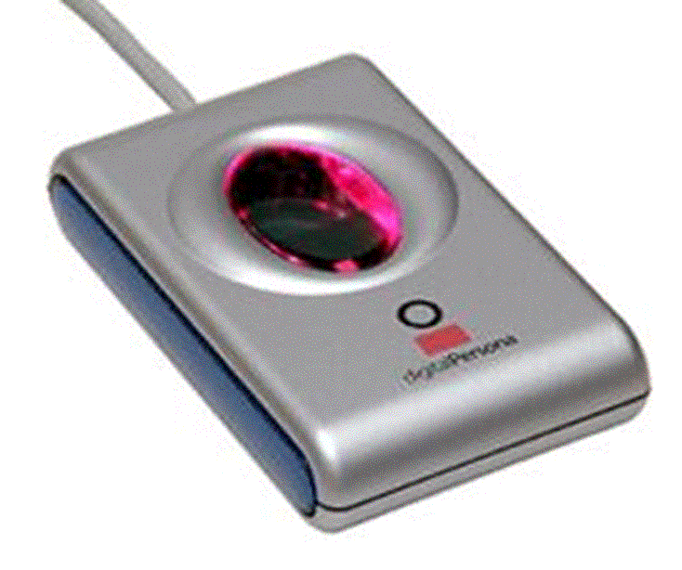
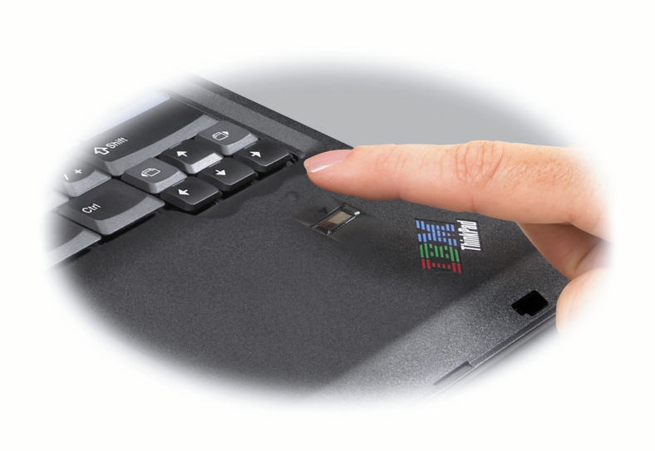
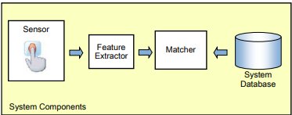




Something you are/do (Inherence-based)
Biometric - “You are your key”
Examples:
Fingerprint
Handwritten signature
Facial recognition
Speech recognition
Iris
Voice
…

Slide 13
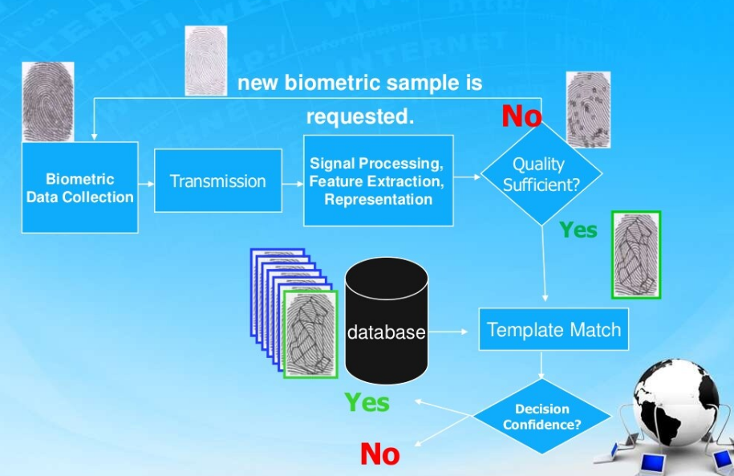

Slide 14
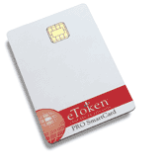

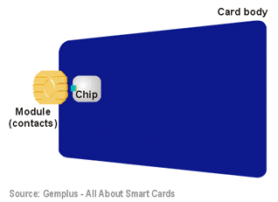





Something you have (Ownership-based)
E-Token: store credentials such as passwords, digital signatures and certificates, and private keys
RFID: Integrated circuit(s) with an antenna that can respond to an RF signal with identity information
Smart card
Digital Certificates (used by Websites to authenticate themselves to customers)

Slide 15


One Time Password
Dynamic password that change frequently
Systems using OTPs generate a unique password on demand that is not reusable

Slide 16
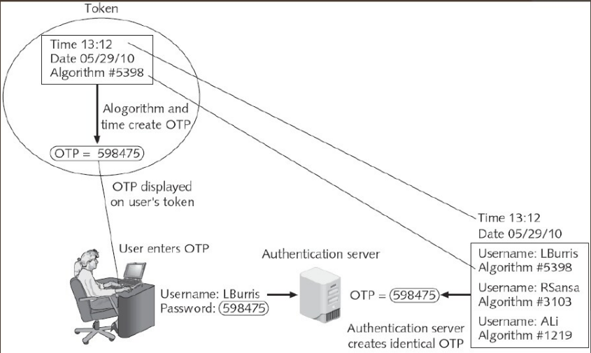
Time-synchronized OTP

Slide 17
Challenge-based OTP
Authentication server displays a challenge (a random number) to the user
User then enters the challenge number into the token (executes a special algorithm to generate a password)
Because the authentication server has the same algorithm, it can also generate the password and compare it against that entered by the user.

Slide 18
Single Sign On
Multiple applications, each requires login
Provide users with the ability to login only once for usability
Automatically propagate login to all applications

Slide 19
Single Sign On
Advantages
Unified mechanism
One login/password to remember
New applications reuse code
Disadvantages
Can weaken security

Slide 20
Implementing authentication
Local authentication
Network authentication

Slide 21






Authentication Server
Radius
Kerberos
TACACS+
LDAP

Slide 22
RADIUS
Wired and Wireless LANs
Radius clients: server, switch, AP
Radius server authenticates and authorized the radius client requests

Slide 23
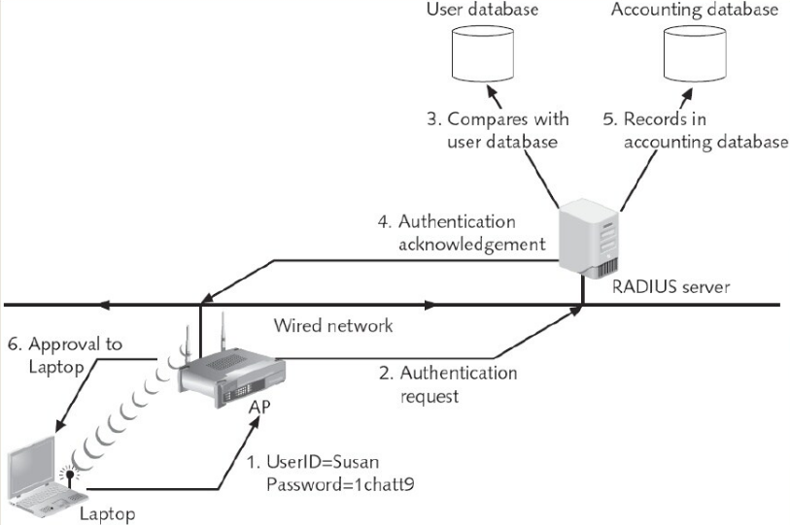



Slide 24
Lab
Password policies
Create an account and test some functionalities:
Minimum the password length
Strong password
Account lockout threshold
WiFi User authentication (WiFi)
WPA2
RADIUS server

Slide 25
Lab. Password Policies
Ubuntu
A strong password should contain:
Upper case letters
Lower case letters
Digits
Symbols
we will use the pwquality module of PAM
$ sudo apt install libpam-pwquality

Slide 26
Now first copy “/etc/pam.d/common-password” file before configuring any changes.
$sudo vi /etc/pam.d/common-password
($sudo vi /etc/security/pwquality.conf)
$sudo vi /etc/login.defs
password requisite pam_pwquality.so retry=4 minlen=9 difok=4 lcredit=-2 ucredit=2
dcredit=-1 ocredit=-1 reject_username enforce_for_root
retry: No. of consecutive times a user can enter an incorrect password.
minlen: Minimum length of password
difok: No. of character that can be similar to the old password
lcredit: Min No. of lowercase letters
ucredit: Min No. of uppercase letters
dcredit: Min No. of digits
ocredit: Min No. of symbols
reject_username: Rejects the password containing the user name
enforce_for_root: Also enforce the policy for the root user

Slide 27


Verify the configuration
$sudo reboot
$sudo useradd namlh
$sudo passwd namlh

Slide 28
Network topology

Slide 29






Summary
Authentication is about validating your credentials such as Username/User ID and password to verify your identity
Multiple factors:
Something you know
Something you have
Something you are
Implementing authentication
Local
network

